Slide 1




Malicious URL detection using Machine Learning
Aryan Nandu - A20583853
Rudra Patel - A20594446
Group 32
CSP571 - Data Preparation & Analysis Group Project
Under Guidance of
Prof. Oleksandr Narykov
Simple PowerPoint Presentation

Slide 2
Table of Contents
References
Introduction
Literature Survey
Methodology
Problem Statement
Real Time Cases
&
Motivation
Comparative Study
Output & Findings

Slide 3
Problem Statement
As the world moves towards digitalization, the use of links has increased exponentially.
Along with their benefits, links also have drawbacks, as users can be misled by hackers reproducing malicious URLs in various ways.
To address this issue, we aim to develop a malicious link detection system that will analyze the URL and predict whether it is benign or malicious.
A machine learning model will be designed to detect malicious links effectively.

Slide 4

Introduction
A URL (Uniform Resource Locator) is the web address used to locate resources on the internet. It consists of a scheme (protocol like http or https), a host (domain name or IP address), an optional path (specific resource location), optional query parameters (additional data), and an optional fragment (a section within the resource).
With the tremendous growth in URL link adoption in emerging markets for financial transactions, contact tracing, contactless registration, user authentication, and verification, the number of link-related frauds has also risen significantly.
Recently, hackers intend to reproduce malicious links utilizing several ways to mislead users.
They try to control victims’ machines or get their data remotely by gaining access to private information they use via cyberspace.

Slide 5
Dataset Source
Source: The dataset for this project was sourced from Kaggle, a platform renowned for its vast repository of machine learning datasets. Specifically, we utilized the Malicious URLs Dataset by user Sid321axn.
Dataset Description:
Total Entries: 651,191 URLs
Benign: 428,103
Malicious: 223,088
Features extracted include lexical characteristics like URL length, hostname length, number of dots, and presence of special characters, among others.
Importance: The dataset provides a balanced representation of real-world benign and malicious URLs, ensuring robust training and testing of our machine learning models.
Justification: Kaggle datasets are often used in research and industry projects due to their quality and diversity, making this dataset an ideal choice for our project..

Slide 6
Real Time Cases
In November 2024, a Chicago resident lost approximately $25,000 to a phishing scam. The individual received an email appearing to be from their bank, prompting them to click a link to verify account information. The link led to a fraudulent website that captured their credentials, allowing scammers to access and deplete their account.
02
01
In September 2024, a Michigan teen was blackmailed via a malicious URL in a extortion scheme, leading to tragic consequences. Cybercriminals demanded $1,000, threatening to leak private images.

Slide 7
Literature Survey
Title: Lexical features based malicious URL detection using machine learning techniques[2]
Author: Raja, A. Saleem, R. Vinodini, and A. Kavitha.
Publisher: Elsevier
Year: 2021
Introduction:
The proliferation of online web services has greatly simplified people's lives, as they increasingly rely on these services for their daily routines. However, this convenience also presents opportunities for cybercriminals to target a large number of victims through carefully crafted, transient malicious URLs or web pages. To address these challenges, researchers use heuristic rule-based detection. This approach employs generalized rules derived from features extracted from datasets. Feature extraction is also foundational for machine learning and deep learning techniques.Machine learning algorithms automatically assign the weightage of selected features and identify the malicious URL including newly generated malicious URLs.
Algorithm Used: Support Vector Classifier (SVC), Naive Bayesian, Logistic Regression, K- nearest neighbor, Random Forest
Results and findings:
This paper introduces an innovative approach to detect malicious URLs using a reduced set of features extracted exclusively from the URL itself. This streamlined approach leads to reduced execution times and storage needs. The paper also reviews recent research in this field and identifies shortcomings in existing methods. The results indicate that the random forest classifier outperforms other classifiers in terms of accuracy. However, when considering both execution time and accuracy, the k-NN classifier delivers superior results compared to the other classifiers.

Slide 8
Literature Survey
Title: Malicious URL Detection using Logistic Regression[2]
Publisher: IEEE xplore
Year: 2021
Introduction:
Attackers often create URLs with their own specific structure, which they may distribute across various platforms. Unwittingly, we can click on these URLs and inadvertently become victims of their schemes. These malicious URLs can be sent through email messages, shared on Twitter, or employed through other means. Blacklist method is both time-consuming and labor-intensive because it involves continuously updating the list due to the constant emergence of new malicious URLs. Furthermore, it's not effective in identifying suspicious URLs that aren't already on the list.To address the drawbacks associated with blacklisting methods, machine learning techniques are employed. This is because machine learning algorithms have the capability to autonomously learn and adapt. Machine learning algorithms are particularly adept at recognizing newly emerging forms of malicious URLs utilized by attackers.
Algorithm Used:
Logistic Regression
Results and Findings:
In this study, a method has been developed to prevent real-time URL spamming using a machine learning algorithm based on logistic regression. The proposed system includes a frontend plugin that categorizes URLs as either safe or malicious. This approach not only identifies malicious URLs but also provides users with information about the type of URLs to avoid in order to protect themselves from cyber attacks.
Gaps and Remarks:
More effective feature extraction and classification techniques aren’t used.

Slide 9
Literature Survey
Title: Malicious URL Detection: A Comparative Study[3]
Author: Janet, B., and R. Joshua Arul Kumar.
Publisher: IEEE Xplore
Year: 2021
Introduction:
Covid 19 significantly impacts online businesses like e-banking, e-commerce, and social networking, but also exposes advanced techniques for user exploitation, including malicious websites stealing private information.The paper evaluates machine learning classifiers for detecting malicious URLs using a public Kaggle dataset. The best classifier was used to detect malicious URLs from openphish websites.
Algorithm used:
Logistic Regression (LR), Random Forest (RF), Support Vector Machine(SVM), Na ̈ıve Bayes (NB), K-Nearest Neighbours (KNN), and Decision Tree (DT).
Results and findings:
We can infer that the models used attain high prediction accuracy however random forest attains the highest F1 score and accuracy almost close to 99.6%
Remarks/Gaps:
The accuracy of the trained random forest classifier on openphish data can be increased by training it on a more balanced data
i.e., the data containing malicious and benign websites in almost equal proportion.

Slide 10
Literature Survey
Title: Malicious URL Detection based on Machine Learning[4]
Publisher: International Journal of Advanced Computer Science and Applications.(IJACSA)
Year: 2020
Introduction:
In today's digital landscape, the proliferation of network threats, particularly malicious Uniform Resource Locators (URLs), presents a critical security challenge. Hackers exploit end-to-end technology and human vulnerabilities through tactics like social engineering and phishing. This paper introduces a novel method employing machine learning and big data technology to detect malicious URLs. By leveraging unique URL behaviors and attributes, our approach significantly enhances detection capabilities, providing an optimized and user-friendly solution for bolstering cybersecurity.
Algorithm used:
Signature-based Malicious URL Detection:Signature-based detection involves using predefined sets of known malicious URLs. When a user accesses a URL, it is checked against a database of blacklisted URLs.
Machine Learning-based Malicious URL Detection: Support Vector Machine (SVM) and Random Forest (RF)
Results and findings:
Using the best-performing algorithm (RF with 100 trees) the model achieved:
True Positives (TP): 92.174% ,False Positive Rate (FPR): 12.037% ,True Negatives (TN): 87.963%, False Negatives (FN): 7.826%
The RF algorithm, with its speed and high accuracy, proved to be well-suited for classification problem.
Remarks/Gaps:
Imbalanced Data: The paper acknowledges an imbalance between safe and malicious URL dataset.
The paper does not elaborate on the rationale for selecting these specific algorithms. Providing a comparison or justification for their choice would strengthen the paper.

Slide 11
Literature Survey
Title: Malicious URL Detection using Machine Learning: A Survey[5]
Publisher:Association for Computing Machinery.
Year: 2019
Introduction:
The rapid growth of the Internet has led to an escalation in cyber threats worldwide. Phishing websites, aiming to collect sensitive information, have become a prevalent form of attack. While traditional security measures face limitations, the use of machine learning offers a promising solution. This survey delves into the state-of-the-art techniques in malicious URL detection, focusing on feature representation and learning algorithms. By categorizing strategies and discussing emerging concepts, this survey provides valuable insights into countering cyber threats effectively.
Algorithm used:
Support Vector Machines (SVM), Logistic Regression,Online Gradient Descent (OGD), Passive-Aggressive Learning (PA),Convolutional Neural Networks (CNNs),Recurrent Neural Networks (RNNs).
Results and findings:
The findings indicate that a wide range of machine learning techniques have been applied to the task of detecting malicious URLs. Each category of algorithm has its strengths and applications, and researchers have explored various strategies to address challenges such as high data volume, difficulty in acquiring labels, and feature representation.The survey acknowledges the substantial progress made in the field of malicious URL detection using machine learning. However, it also highlights several areas where further research and development are needed:Feature Extraction and Representation Learning, Emerging Challenges (e.g., Domain Adaptation).
Gaps and Remarks:
The article recognizes the progress made in the field, but it also underscores the ongoing challenges and the need for further advancements, particularly in feature representation, machine learning algorithms, adaptability to dynamic environments, and addressing emerging cybersecurity issues.

Slide 12
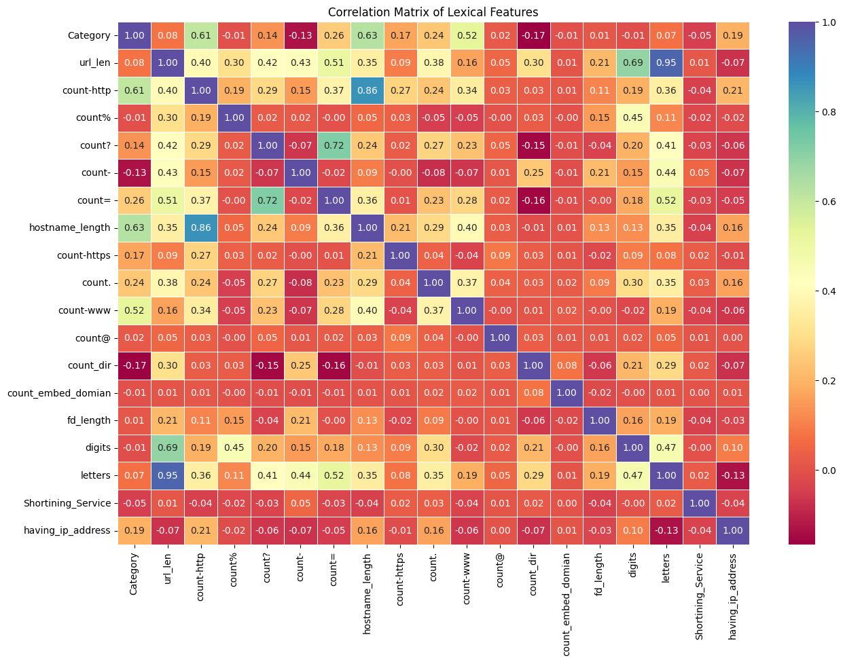
Correlation Heatmap
Literature Survey
Purpose: Displays the correlation values between various lexical features and the target variable (Category) as well as among the features themselves.
Color Coding:
Values closer to 1 (dark yellow) indicate strong positive correlations.
Values closer to -1 (dark purple) indicate strong negative correlations.
Values near 0 (red/orange) indicate minimal or no correlation.
High Correlations with Target (Category):
hostname_length and count-http show strong positive correlations with Category.
Inter-feature Correlations:
hostname_length and count-http exhibit a very high correlation (0.86), indicating these features are closely related.
url_len and letters are also strongly correlated (0.95).
Minimal Correlations:
Features like Shortening_Service, count_embed_domain, and fd_length show negligible correlation with Category and other features.
Negative Correlations:
Some features, like count_dir, show weak negative correlations with the Category.
Visualization Use: Helps identify features that are highly correlated (positively or negatively) for further feature selection or engineering.

Slide 13
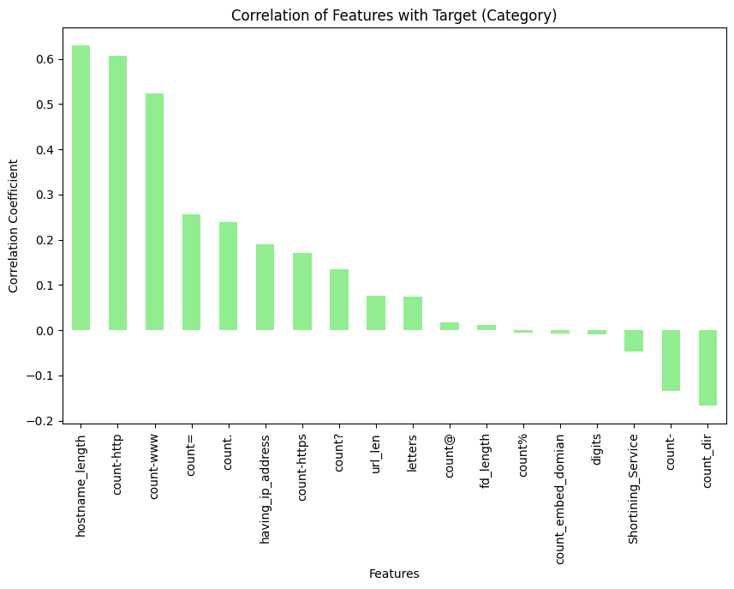
Correlation between Features and Target Variable
Purpose: The chart shows the correlation coefficients of different features with the target variable (Category).
Feature Ranking: Features are ranked based on their correlation values, from highest to lowest.
Strong Positive Correlations:
hostname_length has the highest positive correlation.
Followed by count-http and count-www.
Strong Negative Correlation:
count_dir exhibits the strongest negative correlation with the target.
Minimal Correlations:
Features like fd_length and count% have correlation values near zero, indicating little to no relationship with the target.
Interpretation: Positive correlations indicate a direct relationship, while negative correlations indicate an inverse relationship with the target.

Slide 14
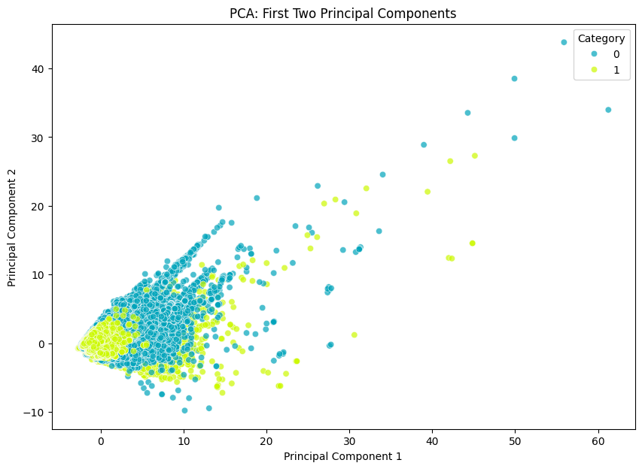
PCA Analysis
PCA (First Two Principal Components)
Purpose: Projects high-dimensional data onto two principal components to visualize variance.
Category Representation: Data points are color-coded based on two categories (0 and 1).
Data Spread: The majority of the data is concentrated near the origin, with a gradual spread along Principal Component 1.
Clustering Insight: Shows partial separation between the two categories, though significant overlap suggests possible similarity or noise in the dataset.
Analysis Utility: Useful for identifying inherent separability or relationships between the two categories in a lower-dimensional space.

Slide 15
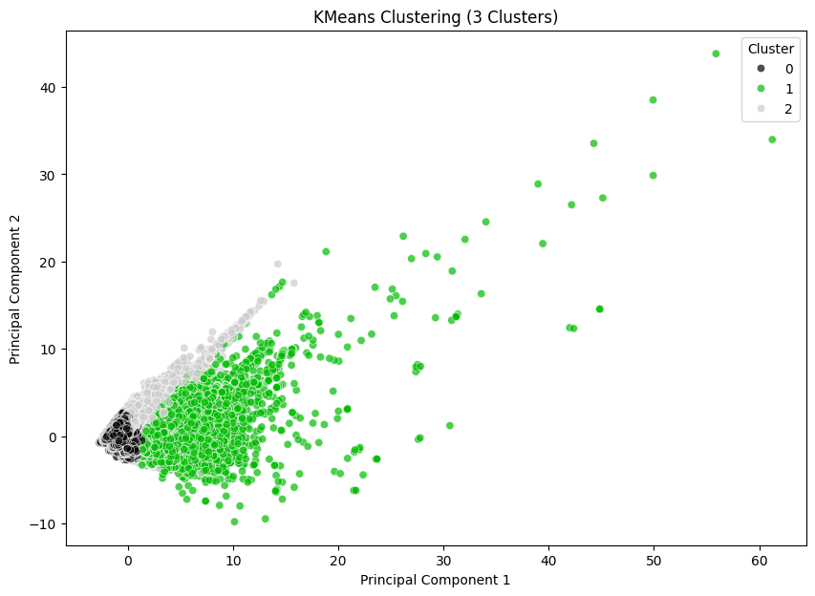
K-Means Clustering
KMeans Clustering (3 Clusters)
Purpose: Demonstrates KMeans clustering applied to the PCA-reduced data to identify group patterns.
Cluster Distribution: Data is segmented into three clusters (0, 1, and 2), shown with distinct colors.
Cluster Formation:
Cluster 0 (black) covers dense regions around the origin.
Cluster 1 (green) forms around the periphery of the dense region.
Cluster 2 (gray) spans more dispersed areas.
Overlapping Regions: Overlap exists between clusters, particularly in densely packed areas, indicating potential challenges in clustering effectiveness.
Application Insight: The clustering provides an unsupervised approach to group similar data points, which can be compared with the original categories for evaluation.

Slide 16
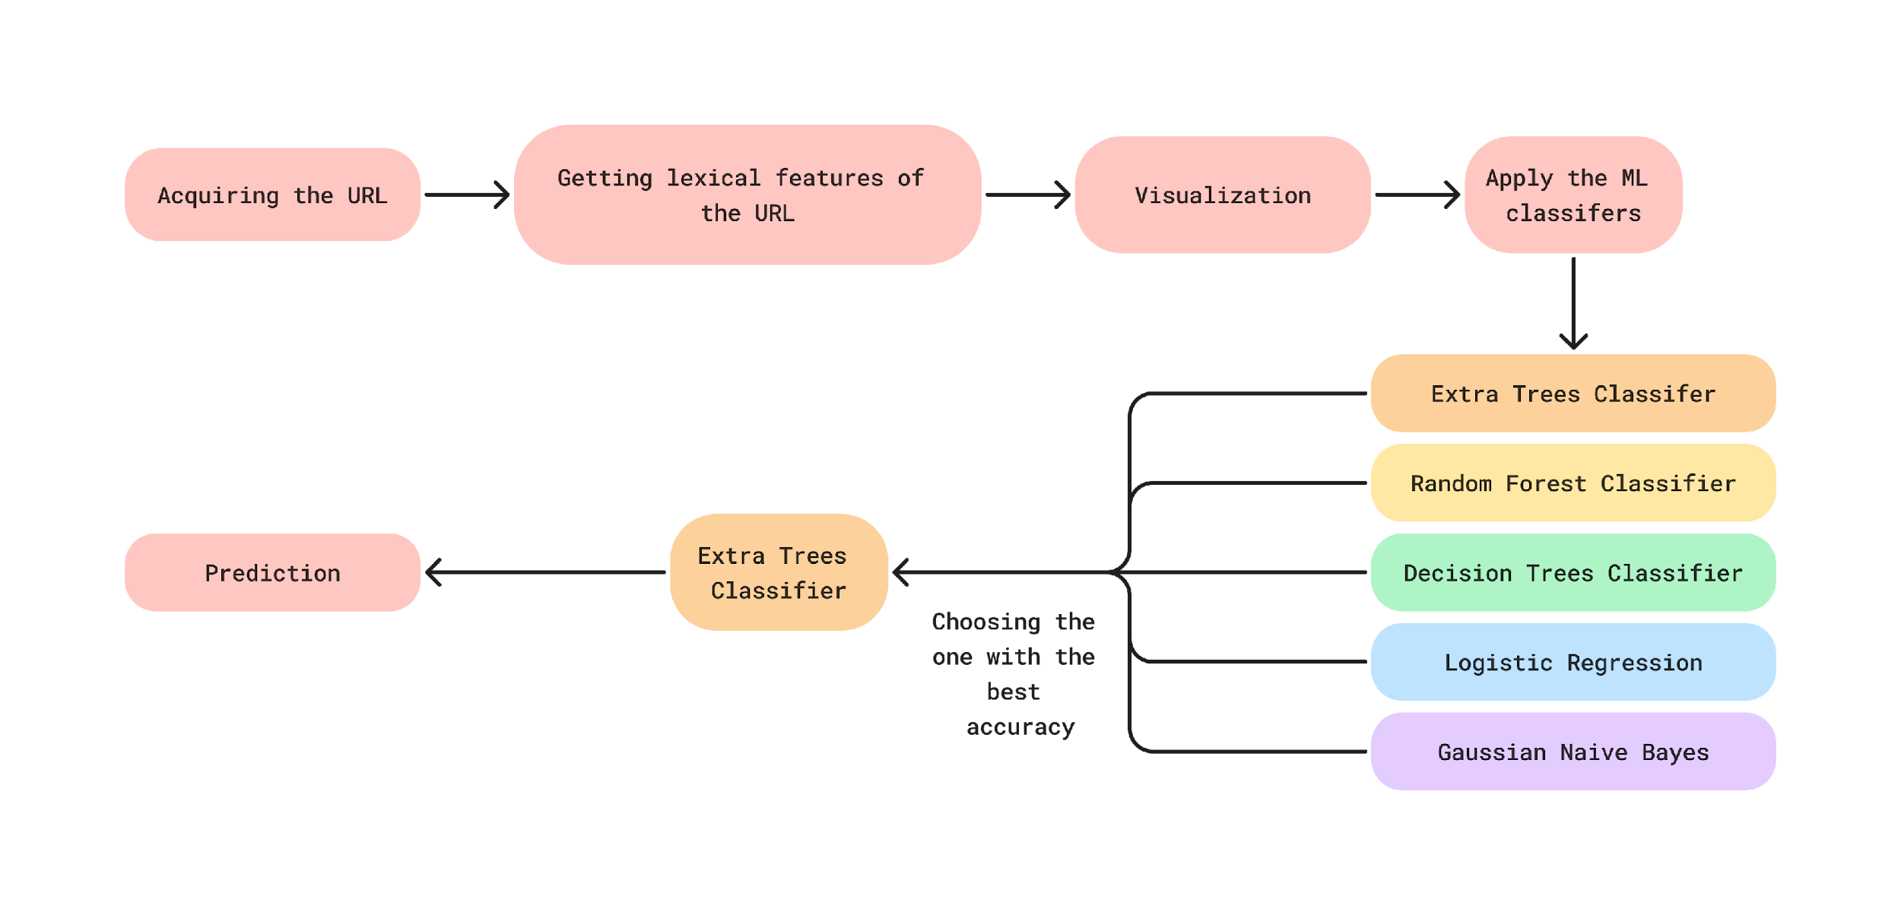
Methodology

Slide 17
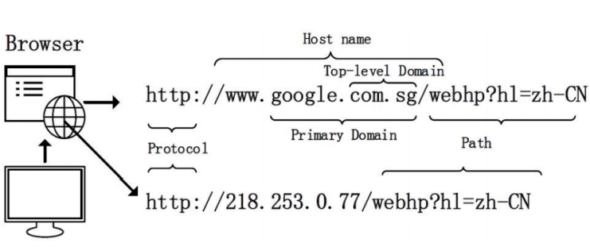
Lexical Features Used:
Length of url
Count of "http"
Count of percent
Count of question "?"
Count of hyphen "-"
Count of equal "="
Length of hostname
Count of https
Count of www
Count of dot "."
Count of atrate "@"
Number of directories
number of embedded url
Length of First directory
Count of digits
Count of letters
Use of shortening url services
Url containing ip address

Slide 18
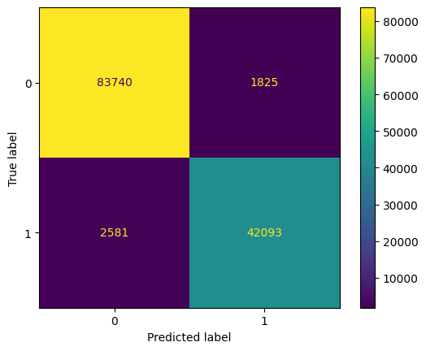
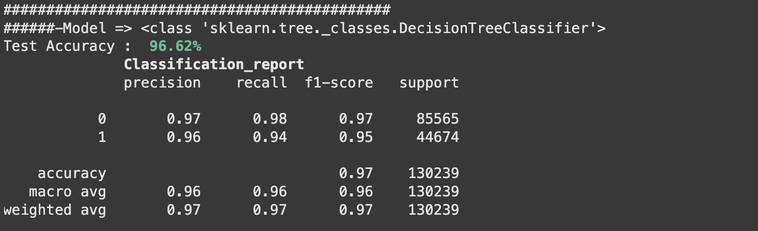
Outputs & Findings
Decision Tree :
A Decision Tree is a machine learning model that uses a tree-like structure to make decisions or predictions.
It splits the data into subsets based on the most important attributes at each level, leading to a final decision at the leaf nodes.
It’s a transparent and interpretable algorithm used for classification and regression tasks and is especially useful when you want to understand and visualize the decision making process of the model.
Confusion Matrix

Slide 19

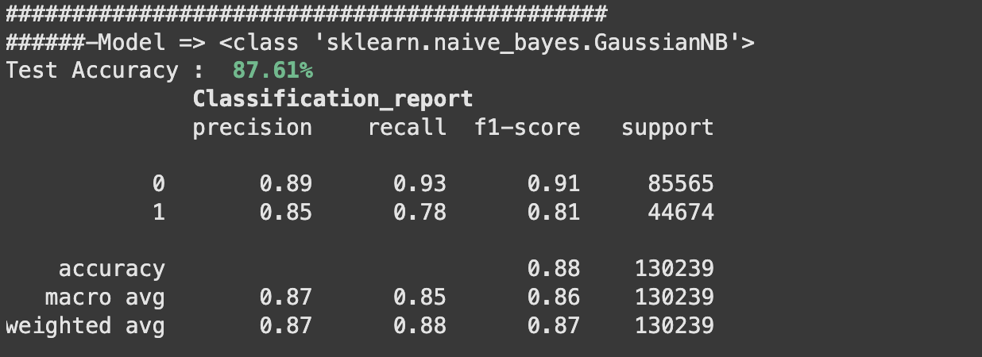
Outputs & Findings
Gaussian Naive Bayesian :
Gaussian Naive Bayes is a variant of the Naive Bayes classifier.
It assumes that the features follow a Gaussian (normal) distribution. Despite the ”naive” assumption of feature independence, it’s effective in text classification and continuous data.
It calculates the probability that a data point belongs to a particular class based on the likelihood of the features and prior probabilities of the classes, making it a valuable tool for classification tasks
Confusion Matrix

Slide 20

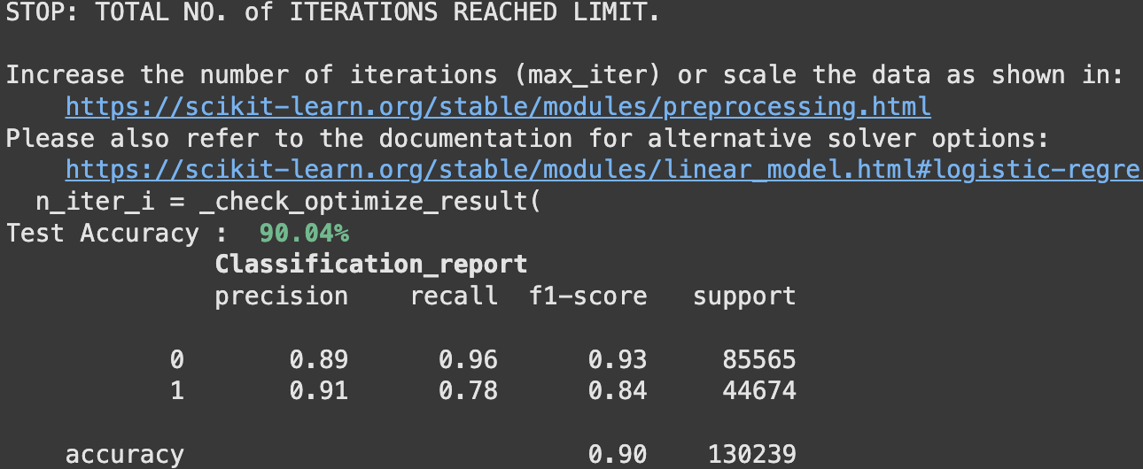
Outputs & Findings
Logistic Regression:
Logistic regression is a classification method that calculates the probability of an event happening based on input variables.
It’s used for tasks like spam detection or disease prediction.
Unlike linear regression, it produces values between 0 and 1, representing probabilities.
Confusion Matrix

Slide 21

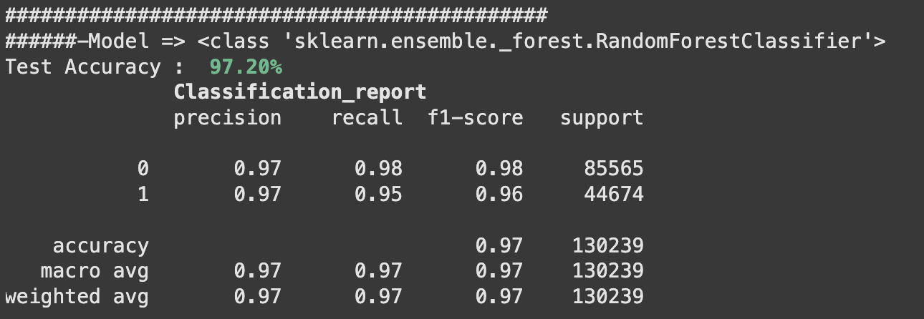
Outputs & Findings
Random Forest :
Random Forest is an ensemble learning method that combines multiple decision trees to make more accurate predictions.
It works by creating a ”forest” of decision trees and aggregating their outputs. This reduces overfitting and enhances the model’s robustness.
RandomForest is widely used for classification and regression tasks, offering excellent performance and the ability to handle complex data with high-dimensional feature sets.
Confusion Matrix

Slide 22

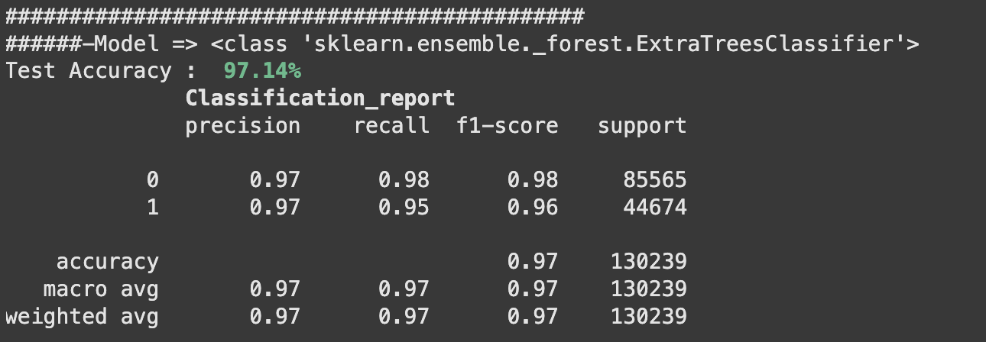
Outputs & Findings
Extra Trees :
Extra Trees, short for Extremely Randomized Trees, is an ensemble learning technique similar to Random Forest.
It builds multiple decision trees, but with a key difference: it uses random feature selection and random splitting thresholds at each node.
This randomness makes ExtraTrees less prone to overfitting and often results in faster training.
It’s a powerful algorithm for classification and regression tasks, particularly when dealing with noisy or high-dimensional data.
Confusion Matrix

Slide 23
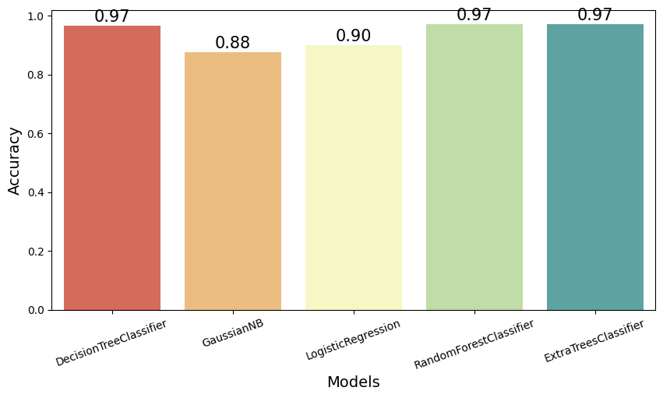
Comparative Result

Slide 24
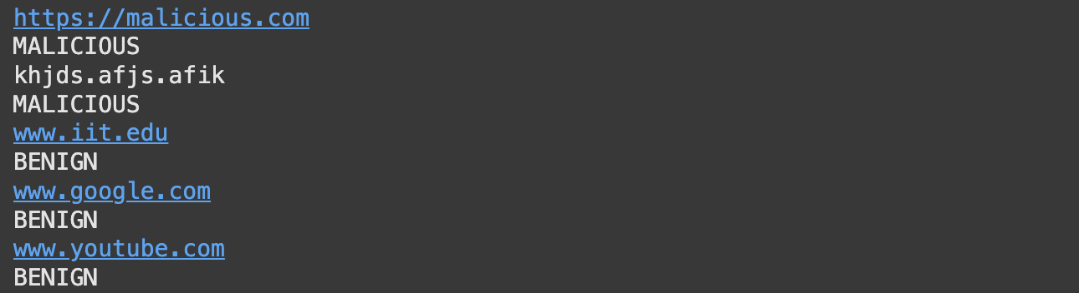
Results
Based on the accuracy of each classifier in the above figure it can be summarized that Decision Tree, Random Forest and lastly Extra Tree has the best accuracies. So we will consider Extra Tree as our main model for prediction whether the URL is benign or malicious, because the computation time is less.

Slide 25
Future Scope
18 lexical features are implemented, in future more lexical features will be added for more accurate results.
The current dataset comprises 651,191 entries, with an imbalance between benign and malicious samples. To ensure a more equitable representation and enhance analytical accuracy, the dataset will be expanded to achieve a balanced ratio of benign to malicious data points.
Also this is command line execution. An application will be built.
The application will scan the QR code and will identify that the QR code is malicious or benign.
If the QR is benign it will redirect to particular page, if it is malicious it will ask whether you want to exit or run anyways.

Slide 26
Conclusion
A machine learning-based system was created to detect malicious QR codes, distinguishing them from harmless ones.
The model was trained and tested using a dataset comprising both types of URLs..
Various visualizations were employed to effectively analyze patterns, relationships, and insights within the data, aiding in the overall understanding and interpretation of the results.
It utilizes 18 lexical cues to reliably determine if a URL is malicious or benign.
This system helps uncover cybersecurity vulnerabilities and ensures consumer protection during daily interactions.

Slide 27
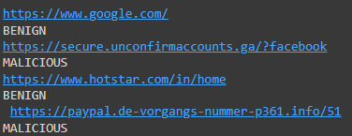
Summary
Based on the accuracy of each classifier in the above figure it can be summarized that Decision Tree, Random Forest and lastly Extra Tree has the best accuracies. So we will consider Extra Tree as our main model for prediction whether the QR is benign or malicious

Slide 28
Bibliography
[1] Raja, A. Saleem, R. Vinodini, and A. Kavitha. ”Lexical features based malicious URL detection using machine learning techniques.” Materials Today: Proceedings 47 (2021): 163-166.
[2] AP, Mrs Latha, et al. ”Malicious URL Detection using Logistic Regression.”
[3] Janet, B., and R. Joshua Arul Kumar. ”Malicious URL detection: a comparative study.” 2021 International Conference on Artificial Intelligence and Smart Systems (ICAIS). IEEE, 2021.
[4] Do Xuan, Cho, Hoa Dinh Nguyen, and Victor Nikolaevich Tisenko. ”Malicious URL detection based on machine learning.” International Journal of Advanced Computer Science and Applications 11.1 (2020).

Slide 29
THANK YOU

